Slide 1

Fixing Recurring Crash Bugs via Analyzing Q&A Sites
Author: Qing Gao, Hansheng Zhang, Jie Wang, Yingfei Xiong, Lu Zhang, Hong Mei
Presenter: Nhat Minh Le – 40323412 – Concordia University

Slide 2
Agenda
I. Overview
IV. Technical contribution
II. Related work
V. Experiment
III. Main novelty
VI. Evaluation
2

Slide 3
I. Overview
Recurring bugs: bugs that occur often in different projects, and are found common
These bugs can affect various aspects of software and have a range of implications across different industries.
Some type of recurring bugs: + Configuration Errors
+ Input Validation and Parsing Errors
+ UI/UX Issues
3

Slide 4
II. Related work
GenProg: copies code pieces from other parts of the software project to fix the current bug
PAR: uses human-written templates to generate patches
RSRepair: assume that patches exist in the current project, and use search-based techniques to find the patches
SPR: instantiates transformation schemas to repair program defects by using condition synthesis
4

Slide 5
III. Main novelty
First new approach: fixing recurring crash bugs via analyzing Q&A sites ( internet resource).
This new approach in this paper focuses only on one type of bug: crash bug
This new approach has the potential for further research and applying in real-worlds
5

Slide 6
IV. Technical contribution
Extracting queries from crash traces
Retrieving a list of Q&A pages
Analyze the pages
Generate edit scripts
Apply these scripts to target source code
Filter out the incorrect patches
1) Page extraction
2) Edit script extraction
3) Patch generation
4) Patch filtering
6

Slide 7
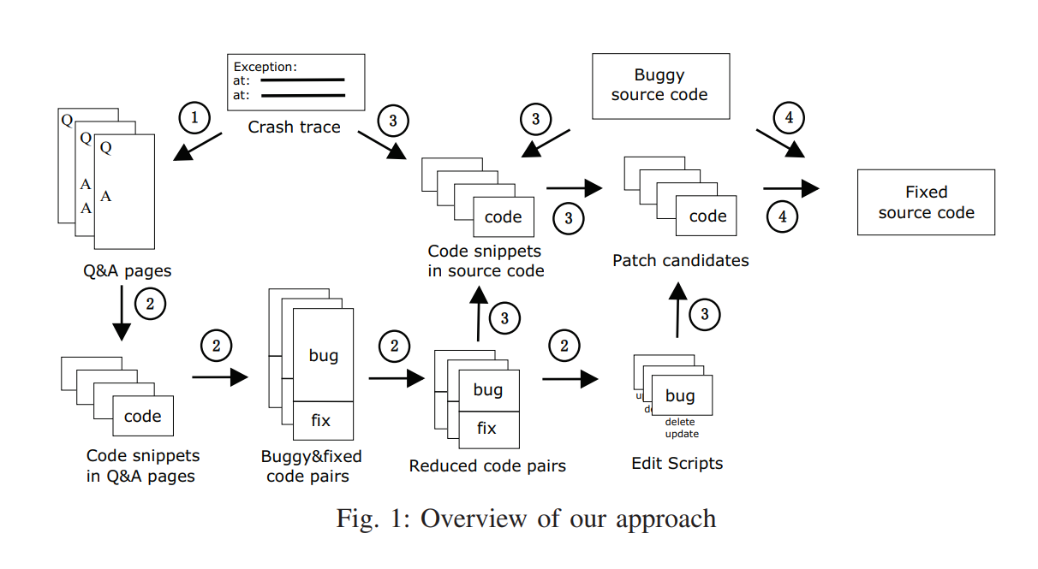
IV. Technical contribution
7

Slide 8
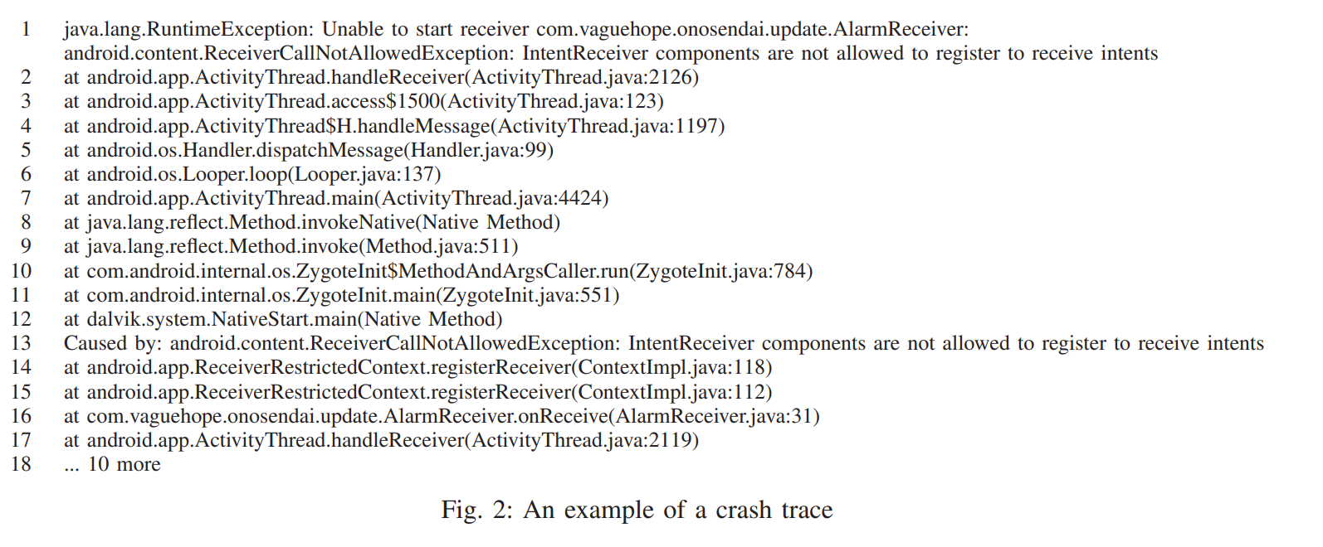
IV.1 Q&A Page Extraction
8

Slide 9
IV.1 Q&A Page Extraction
The query: java.lang.RuntimeException: Unable to start receiver IntentReceiver components are not allowed to register to receive intents
9

Slide 10
IV.2 Edit Script Extraction
Consist 3 steps:
Buggy & fixed code pair extraction
Buggy & fixed code reduction
Edit script generation
10

Slide 11
IV.2.1 Buggy & Fixed code pair extraction
Isolate code snippet from Q&A page by getting the content inside HTML tag pair <code> and </code>
Combine different code snippet to buggy & fixed code pairs
11

Slide 12
IV.2.1 Buggy & Fixed code pair extraction
Buggy & fixed code pair:
1) Both buggy code and fixed code are in the same answer post.
2) Buggy code is in the question post, and fixed code is in the answer post
Question : How to know which is question, which is answer posts ?
1) Use keyword matching to distinguish the buggy code and the fixed code ( instead of, change to…)
2) Take each code snippet in each type post
→ Rank 1) is higher than 2)
12

Slide 13
IV.2.2 Buggy & Fixed code reduction
Reduce the size of both buggy code and fixed code according to their similarities
1. Parse a buggy & fixed code pair and get two Abstract Syntax Trees (ASTs): BuggyAST and FixedAST
AST:
Each node has a label – type of the node ( eg: method invocation)
Each leaf node has a value ( eg: the name of a variable)
13

Slide 14


IV.2.2 Buggy & Fixed code reduction
2. Use partial parsing techniques to parse the code snippets into AST
3. Calculate the similarities between each statements in the code pair
Consider two types of similarities:
Text similarity
Structure similarity
14

Slide 15
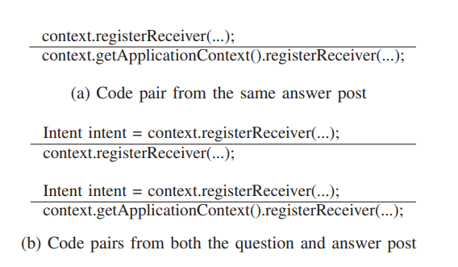
IV.2.2 Buggy & Fixed code reduction
4. Filter out statements which has low similarity score
15

Slide 16
IV.2.3 Edit Script Generation
Use GumTree ( edit script generation technique) to generate edit scripts for buggy code snippets.
Build mappings between the nodes of BuggyAST vs FixedAST
The edit script contains four type of operations on a node: add, delete, update, move
To overcome the problem of change position and rename variable of BuggyAST, the authors add 2 more operations in edit scripts: replace, copy
16

Slide 17
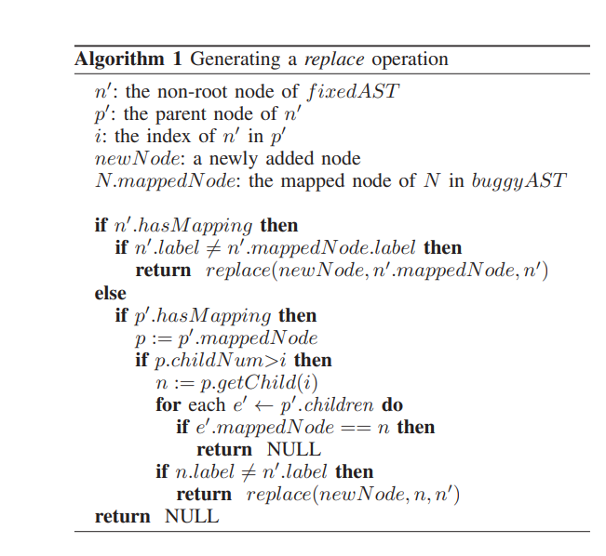
IV.2.3 Edit Script Generation
17

Slide 18
IV.3 Patch Generation
Including 3 steps:
Extracting source code snippets from the target projects
Combining them with buggy code snippets from Q&A pages to obtain a list of buggy & source code pairs
Applying each edit script of the buggy code snippet to the corresponding source code snippet to obtain patches – Edit script application
18

Slide 19
IV.3.1 Extracting source code
Note: If the buggy code snippets is a block, the algorithm consists of 3 steps below:
Use call stack and buggy code to find fault locations
Expand each faulty location inside the candidate files, and combine them to obtain a buggy & source code pair
Choose the previous location and the next location with the same block size as two additional source code snippets.
7
19

Slide 20
IV.3.3 Edit script application
srcAST: source code snippet
Use GumTree to build mappings between buggyAST and srcAST
If there is unmapped node in the edit script, do not generate a fix.
For each buggy & source code pair in order, apply each transformed edit script to srcAST, and transform the edited AST back to code
Obtain a ranking list of generated patches
20

Slide 21
IV.3.3 Edit script application
Factors to sort generated patches
Q&A page ranking
Code pairs in the same answer post is ranked higher than those in both question and answer post
Faulty locations identified by the call stack is ranked higher than those identified by the buggy code
21

Slide 22
IV.4 Patch Filtering
Using the following two rules:
Merging. The approach may generate multiple patches that are equivalent. → Check the equivalence at the AST level, and merge them as one patch.
Compiling. If there is a compilation failure, filter out the patch.
Report the first k patches in the list to the programmer. In the experiment, k=1 because the author sees that there are high accuracy in generating the first patch.
22

Slide 23
V. Experiment
Product:
Language: Java, open source tool: QACrashFix
Tools and Calculation score used:
Search engine: Google
Q&A pages: StackOverflow
Eclipse AST parser ( parse code to AST)
GumTree ( re-implement to build mapping and generate edit scripts)
Sim(Text) = 0.8 and Sim(Structure) = 0.3
Window 7, dual-core 2.50GHz Intel Core5 processor and 8GB memory
23

Slide 24
V. Experiment
24 issues as the final benchmark
Generate a patch for each bug and comparing with developer’s patch
24

Slide 25
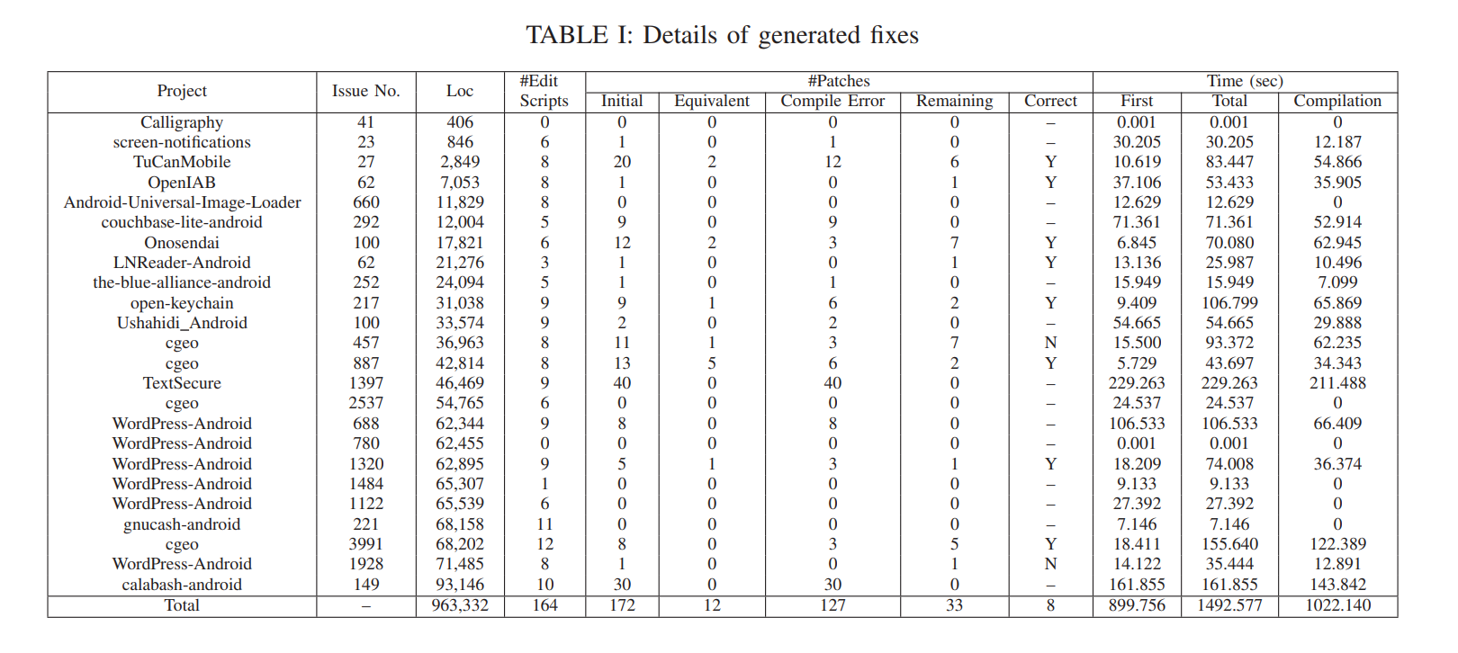
VI. Evaluation
25

Slide 26
VI. Evaluation
RQ1: Effectiveness. How effective is our approach in fixing real-world recurring crash bugs?
For 7 of the 10 bugs, the tool generated correct patches. Among them, patches for 3 bugs are identical to those written by humans, and patches for 4 bugs are not identical, but are still correct.
For 1 of 10 bugs, the tool generated a patch using try and catch blocks as suggested in the Stack Overflow page,
For the rest 2 of the 10 bugs, the tool did not generate correct patches.
→ correctly fix 8 out of 24 bugs with only 2 potential false positives. (where 7 can be directly accepted)
26

Slide 27
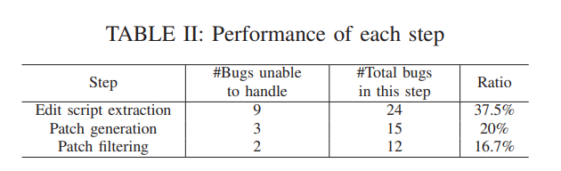
VI. Evaluation
Fail to generate an edit script for 9 bugs, because there are no appropriate code pairs
Fail to generate a patch because cannot locate the buggy code as a result of incomplete crash trace
The remaining 2 bugs cannot be fixed because of compilation errors
27

Slide 28
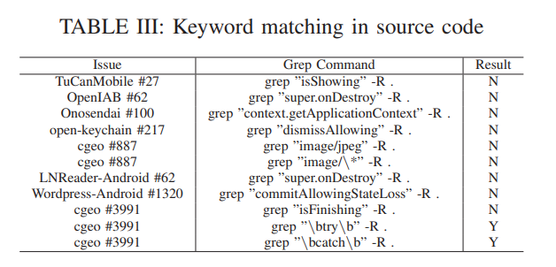
VI. Evaluation
RQ1: Usefullness
Approach can complement existing bug-fixing approaches
28

Slide 29
THANK YOU
29

